Slide 1


Gadget Zone(An E-Commerce Website)
Project by:
Harshit godara (00951202719)
Supervised by:
Arnav Gupta
Coding Blocks
Bharati Vidyapeeth’s College of Engineering, New Delhi

Slide 2

Outline
Introduction
Features and Methodology
Results
References
Bharati Vidyapeeth’s College of Engineering, New Delhi

Slide 3
Introduction
Gadget Zone is a web application which is based on E-commerce Website.
This site is made using HTML, CSS and Javascript.
Gadget Zone allows users to add products to their cart. The added product will be displayed in the cart with its price and quantity.
It also shows the total amount of the items in the cart.
The number of items can be increased, decreased or removed from the cart. Or, all the items from the cart can be removed at once.
Bharati Vidyapeeth’s College of Engineering, New Delhi

Slide 4
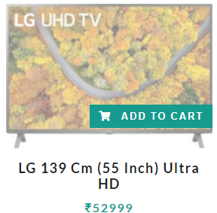
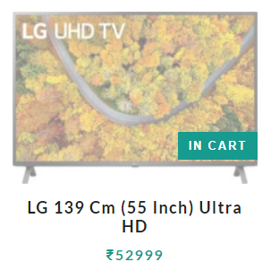

Before adding the product
Features and Methodology
Adding the product to Cart
->To add any product in the cart, hover on the div with class “img-container” i.e product image. On hovering, “ADD TO CART” appears on the item via CSS Transform Property. Click on “ADD TO CART” to add the product in your cart. After adding the product in your cart the button is disabled and its text is also changed to “IN CART”.
->.img-container:hover .bag-btn {
transform: translateX(0);
}
After adding the product
Bharati Vidyapeeth’s College of Engineering, New Delhi

Slide 5

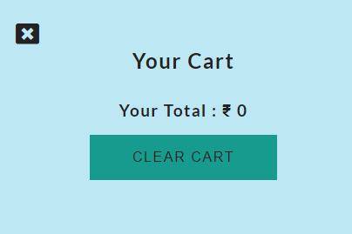
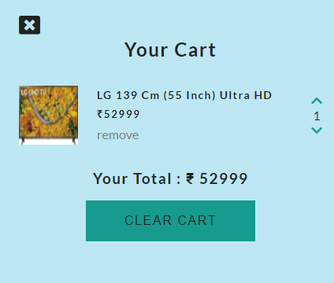
Cart before adding any product
Features and Methodology
Displaying added products in Cart
->After clicking the “Add to Cart” button the added product is displayed in the cart. Cart value is also updated using the “setCartValues()” of UI Class in which total price and item count is updated then the cart is displayed using “showCart()” of same class in which “transparentBcg” class is added to “cart-overlay”.
-> button.addEventListener('click',(event)=>{
event.target.innerText= "In Cart";
event.target.disabled= true;
let cartItem= {...Storage.getProduct(id), amount: 1};
Storage.saveCart(cart)
this.setCartValues(cart);
this.addCartItem(cartItem);
this.showCart();
});
Cart after adding a product
Bharati Vidyapeeth’s College of Engineering, New Delhi

Slide 6
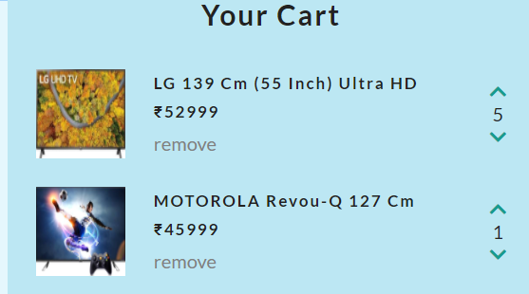
Features and Methodology
->Arrow keys in cart are used to increase or decrease the quantity of products added in the cart. These are imported from Favicon (an online icon generator tool). These buttons are targeted using “fa-chevron-up” and “fa-chevron-down” classes respectively. The targeted id of the product is then checked whether the item is already in the cart or not. I in the cart the quantity increases/decreases on clicking up-arrow/down-arrow button.
-> if(event.target.classList.contains('fa-chevron-up')){
let addAmount= event.target;
let id= addAmount.dataset.id;
let tempItem= cart.find(item => item.id === id);
tempItem.amount = tempItem.amount + 1;
Storage.saveCart(cart);
this.setCartValues(cart);
addAmount.nextElementSibling.innerText= tempItem.amount;
}
Use of Arrow keys in Cart
Bharati Vidyapeeth’s College of Engineering, New Delhi

Slide 7
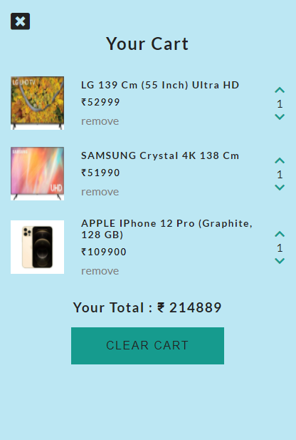
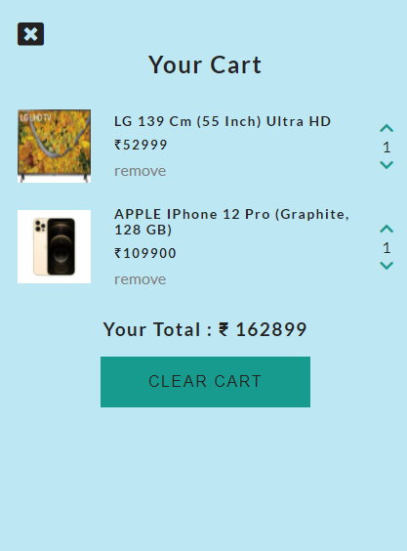
Features and Methodology
->Products can be removed from the cart using the remove and clear cart button. Remove button removes the particular product while clear cart removes all the product in the cart. Remove button is targeted using “remove-item” class. The button is removed via .removeChild() which removes “cart-items” from “cart-content” class. Clear Cart button iterates through each of products in the cart and storing it’s id and then removing them until cart is empty and closes the cart also. Close button closes the cart removing “transparentBcg” from “cart-overlay” and “showCart”
from “cart”.
Remove, Clear Cart and Close button
After removing all the products from cart using clear cart button
Before removing any product
After removing second product using remove button
Bharati Vidyapeeth’s College of Engineering, New Delhi

Slide 8

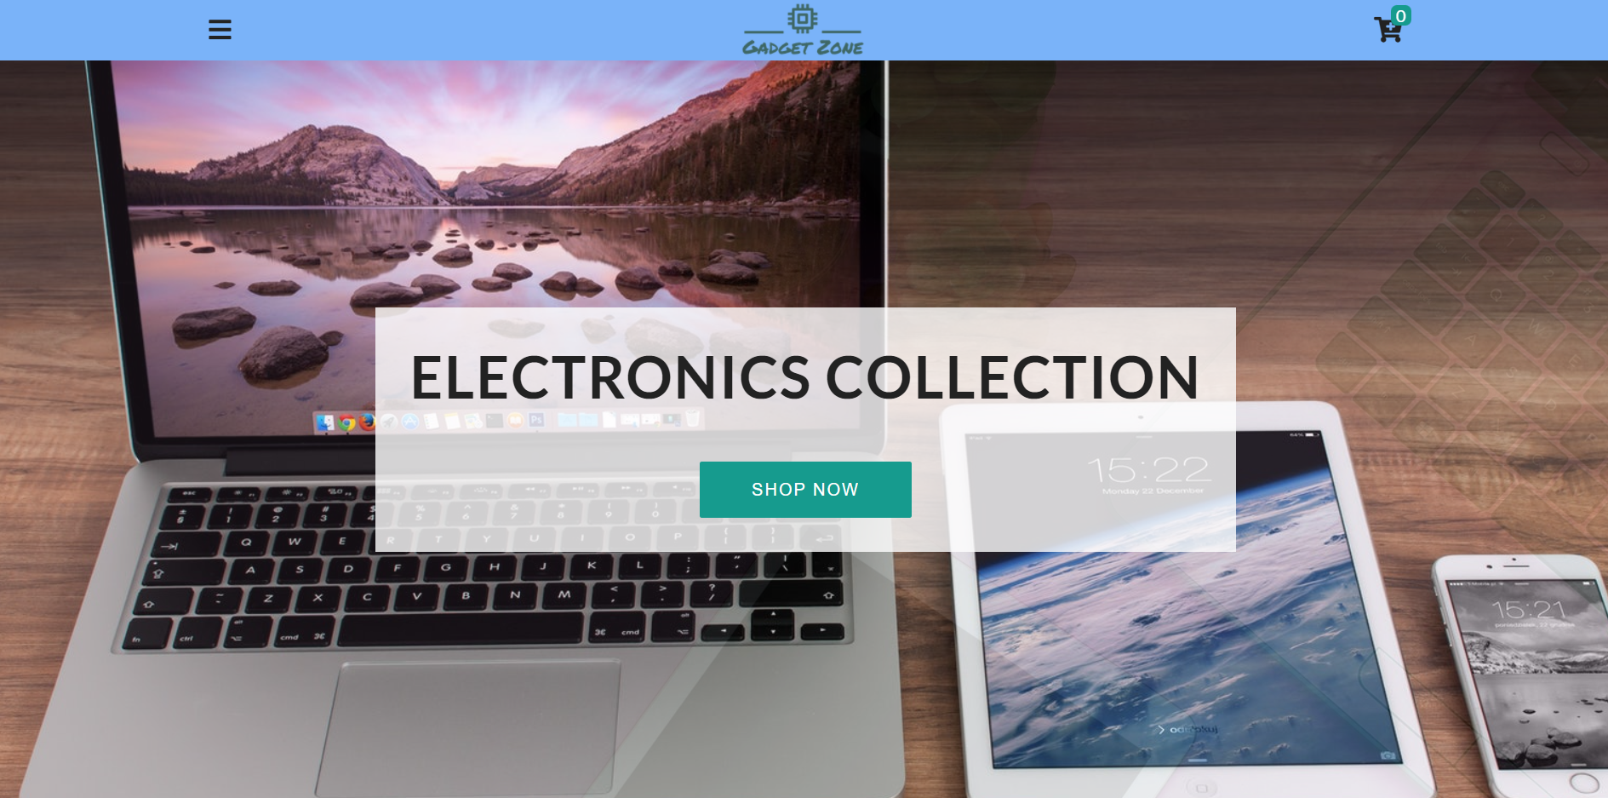
Result
Bharati Vidyapeeth’s College of Engineering, New Delhi

Slide 9
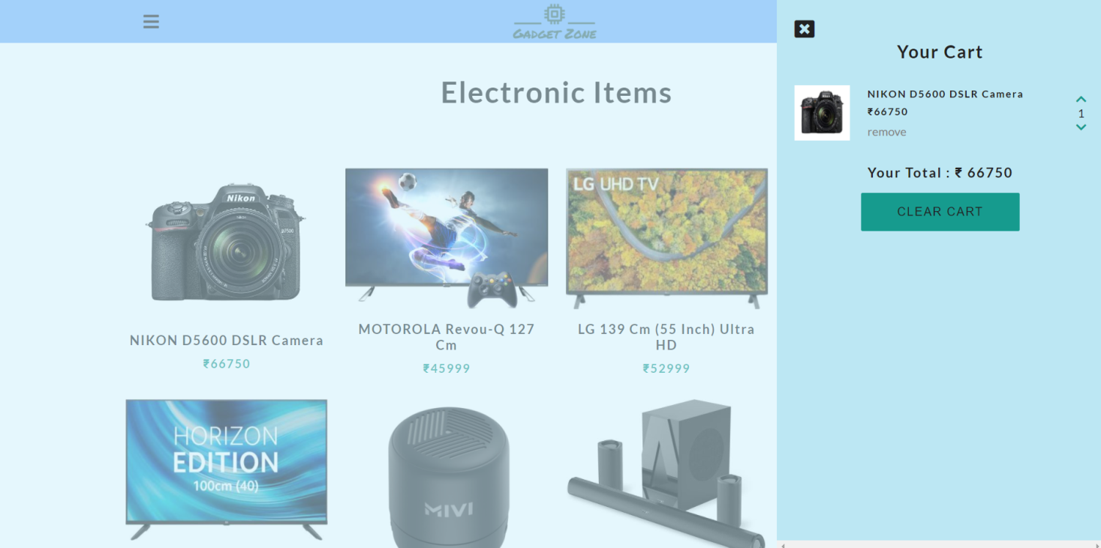
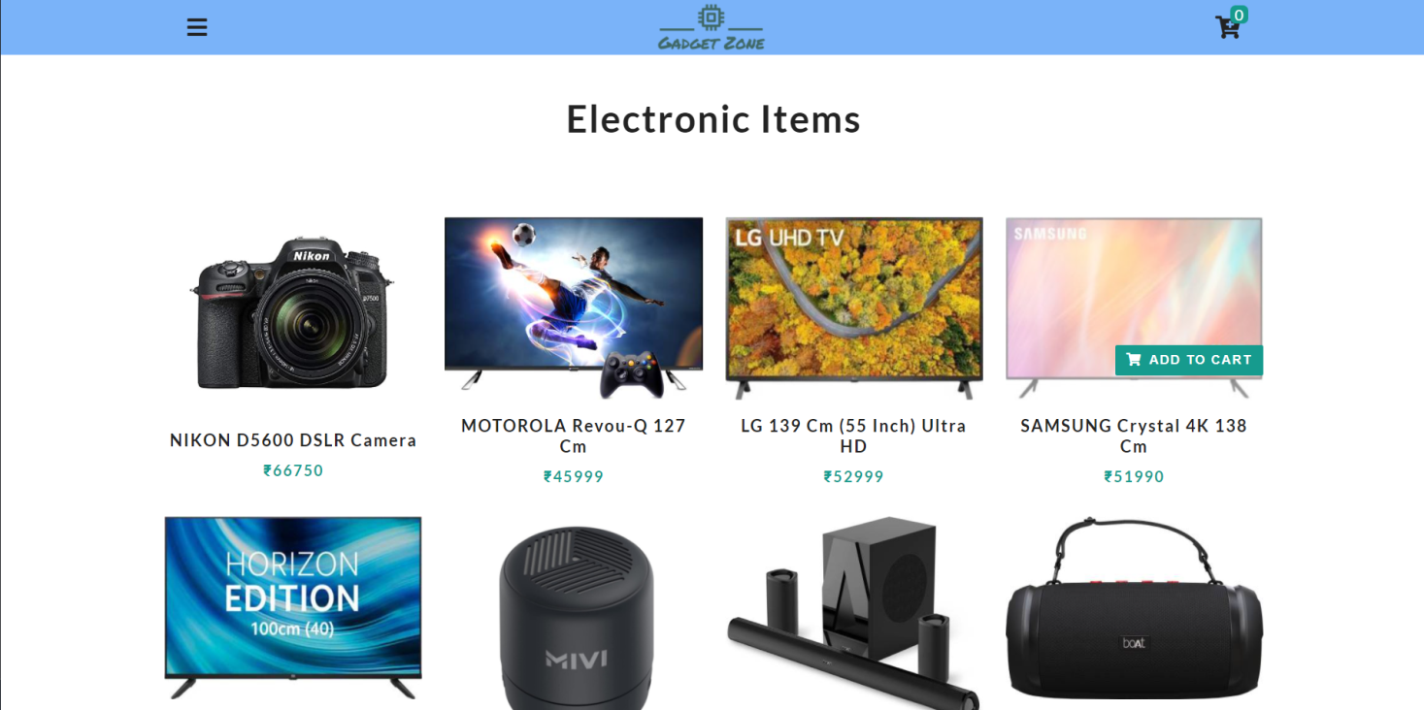
Bharati Vidyapeeth’s College of Engineering, New Delhi

Slide 10
References
https://developer.mozilla.org/en-US/
https://www.w3schools.com/
https://getbootstrap.com/
https://fontawesome.com/
https://fonts.google.com/
https://www.netlify.com/
https://devdocs.io/javascript/
https://developers.google.com/maps/documentation/javascript/overview
https://stackoverflow.com/
Bharati Vidyapeeth’s College of Engineering, New Delhi

